Slide 1

Telecom Churn Prediction
Lucas Phalisch
Ziba Mirza

Slide 2
Objectives
"Predict behavior to retain customers. You can analyze all relevant customer data and develop focused customer retention programs." [IBM Sample Data Sets]
Focus on recall to minimize false negatives, ensuring all cases of churn are correctly predicted
About the dataset:
Contains data of 5’986 customers with those who have left the company in the last month .
Contains attributes like:
Demography: Gender, Senior citizen, Married or single
Relational: Length of tenure, kind of service subscribed for, paperless billing, payment method, type of contract(M/Y)
Behavioral: Streams movies, device protection
Numeric: Monthly bill amount, total paid

Slide 3
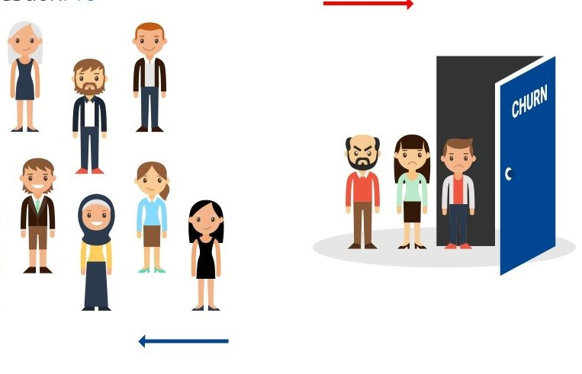
What is Customer Churn?
Customer churn is the percentage of customers that stopped using the company's product or service during a certain time frame.
Top reasons for customer churn (source www.clientsucess.com)
Price
Product
Competition
State of business
Lack of value
Poor experience

Slide 4
Workflow
Model Fitting
Lorem 3
Lorem 3
Lorem 3
Model Interpretation
Lorem 4
Lorem 4
Results
Lorem 5
Lorem 1
Recommendation
Lorem 1
Data Analysis and visualization
-Fixing features types, scaling data
-Separating categorical and numeric columns,
-Find correlation between features and chrn
- Find relation between demographic features and churn
-Understand data imbalance
Using auto ML, low code ML and building prediction models based on results
Three models were tried for best fit:
Random Forest
XG Boost
Log Regression
Applying different feature selection strategies
Using both feature weight and shapley to get insights into what the model is doing
Providing more detail about the results we get and how to interpret them
Recommendations based on our findings and possible action to take

Slide 5
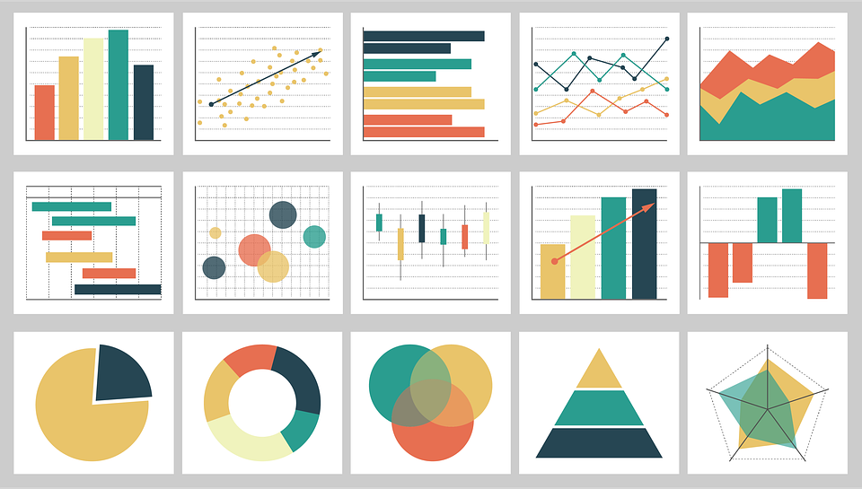
Data Visualization

Slide 6
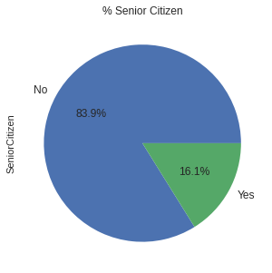
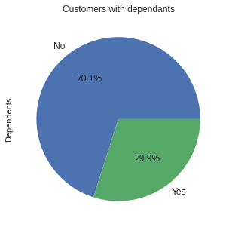
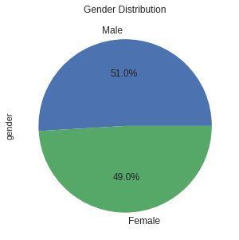
Visualizing Demographic attributes

Slide 7
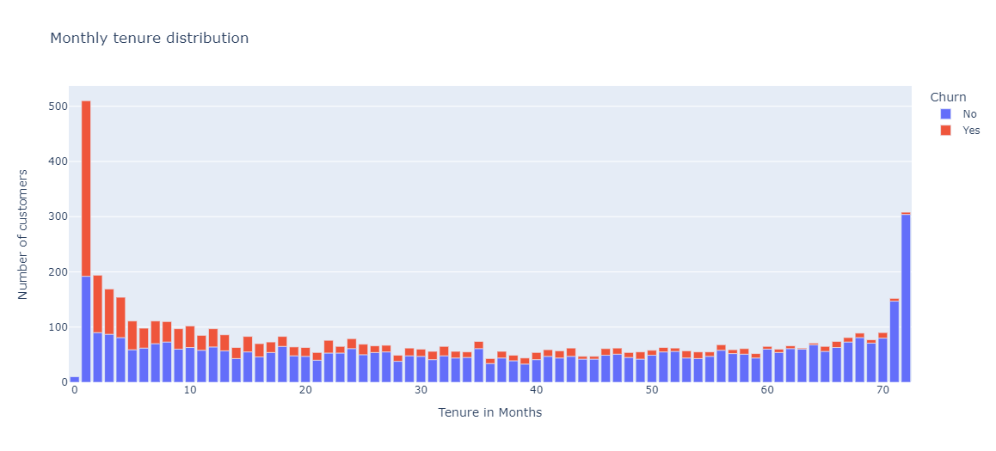
Visualizing Numeric Attributes

Slide 8
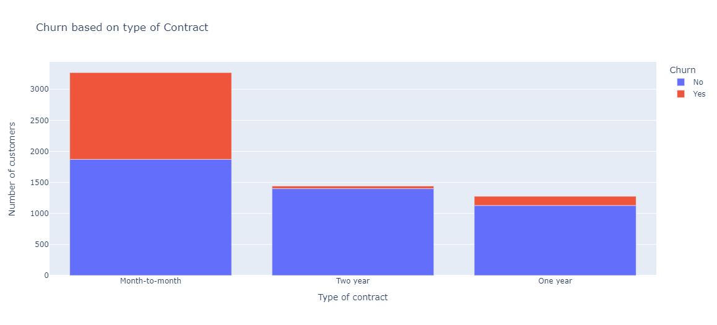
Visualizing Customer Relation Attributes

Slide 9
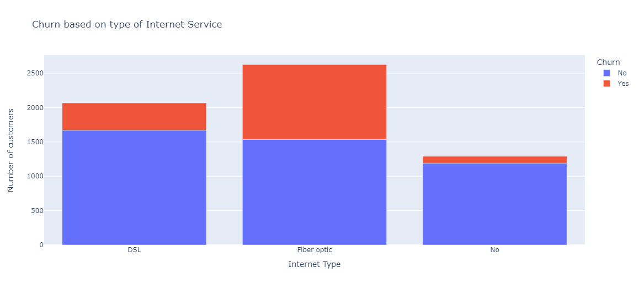
Visualizing Customer Relation Attributes

Slide 10
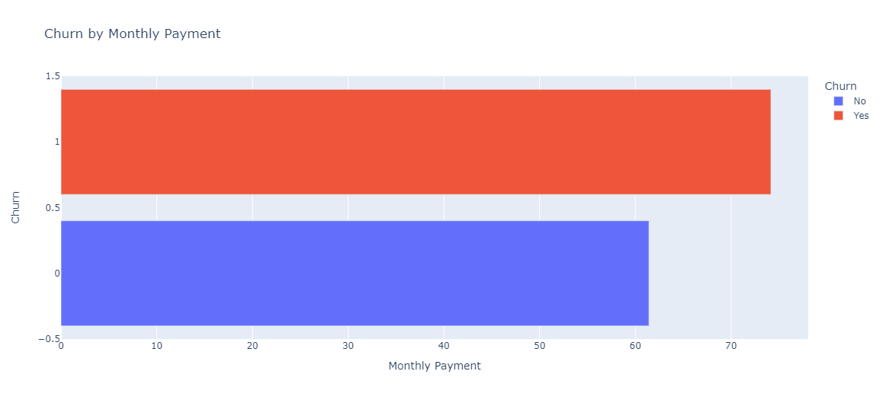
Visualizing Customer Relation Attributes

Slide 11
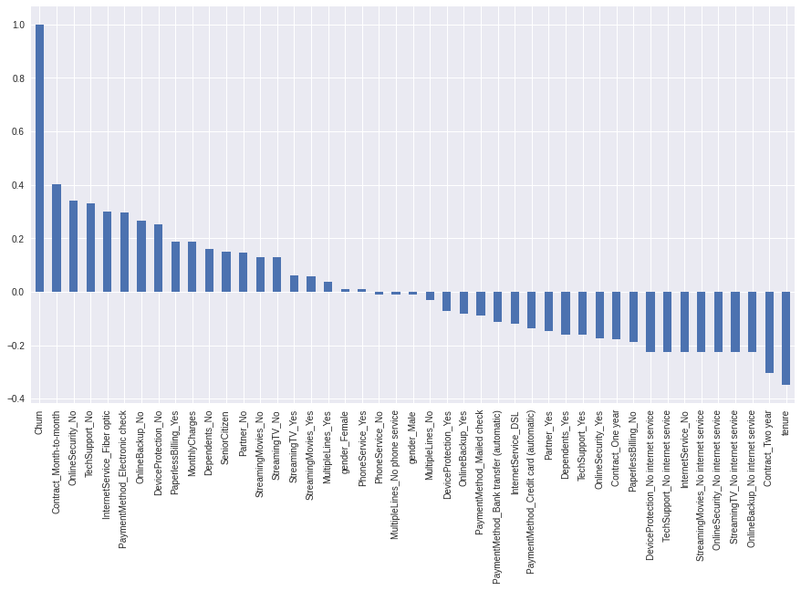
Correlation of all features with Churn

Slide 12
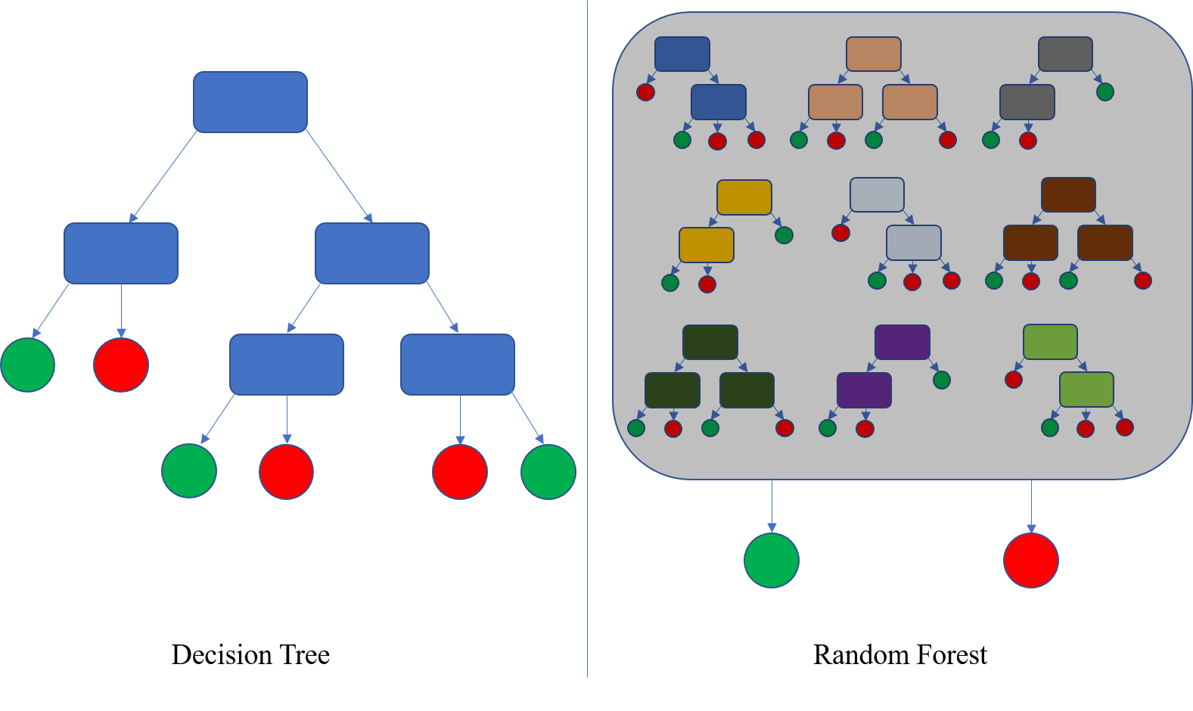
Model Selection

Slide 13
First model with all features
The models performs very well and can predict which customers are gonna churn with 90% reliability
However looking at the feature used by the model reveals something interesting

Slide 14
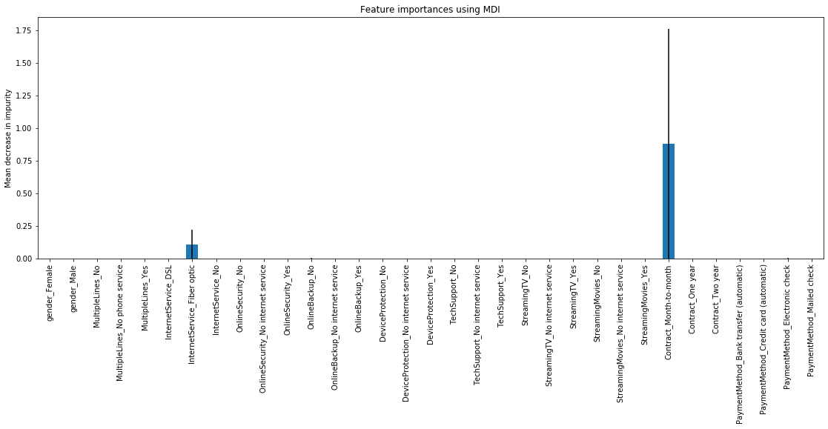
First model with all features

Slide 15
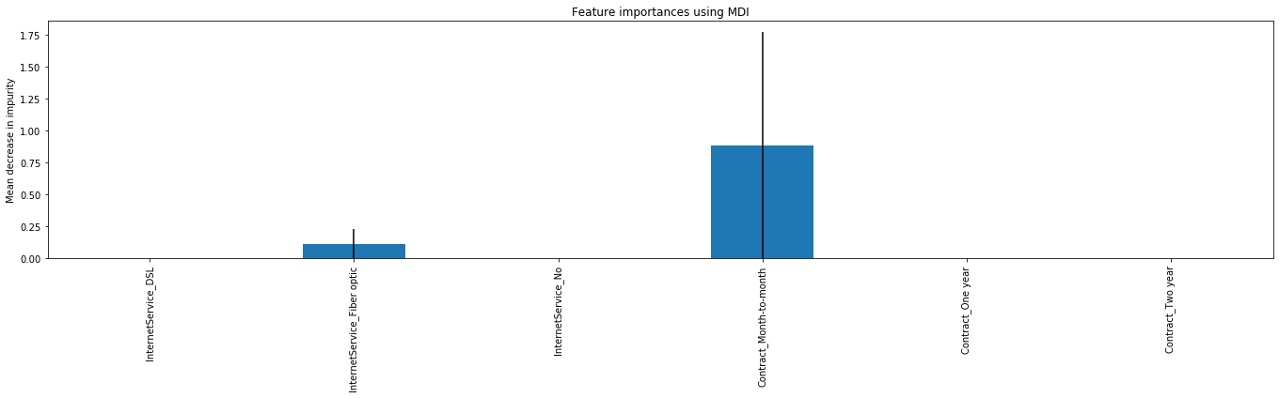
First model with only contract and internet services
Dropping all but two features does not lower performances

Slide 16
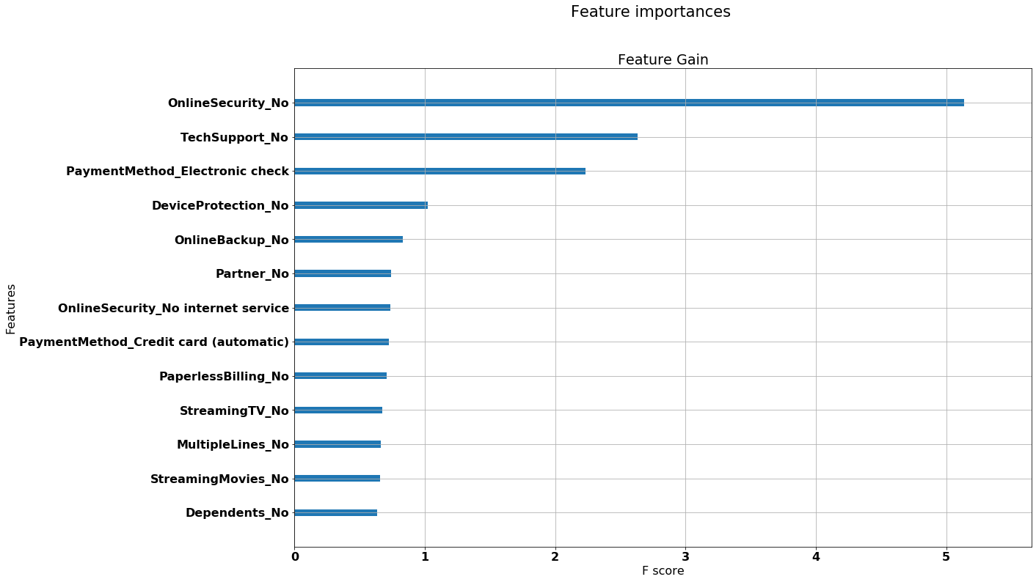
Second model without contract type nor Internet services
The second model is generated without these two feature and still performs well with 82% score

Slide 17
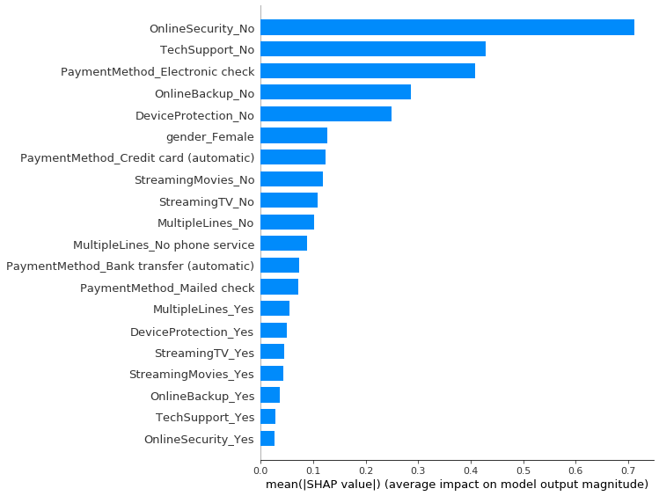
Second model without contract type nor Internet services
A closer look at feature importance using cutting edge techniques reveal the most important feature
Trend one: additional services
Trend two: payment methods
Trend three: gender

Slide 18
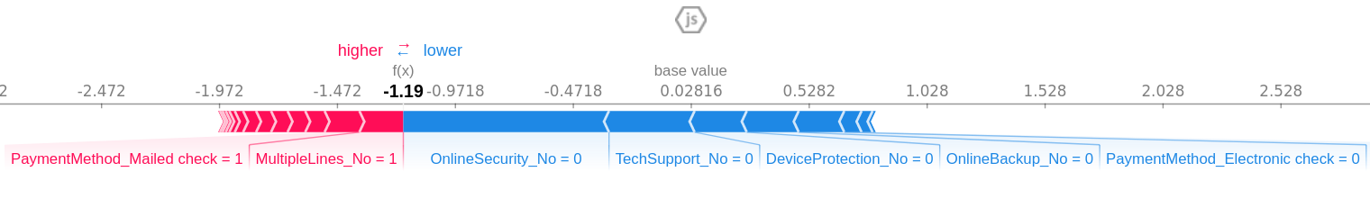
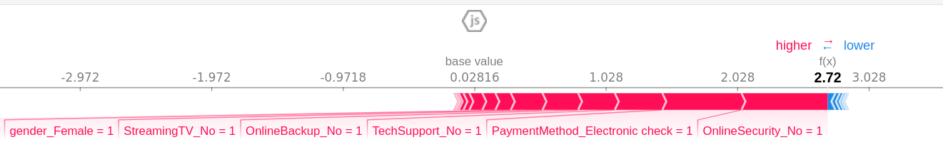
Second model without contract type nor Internet services
Let’s take a look at individual prediction to see the direction of the trends
Negative Prediction
Positive Prediction

Slide 19
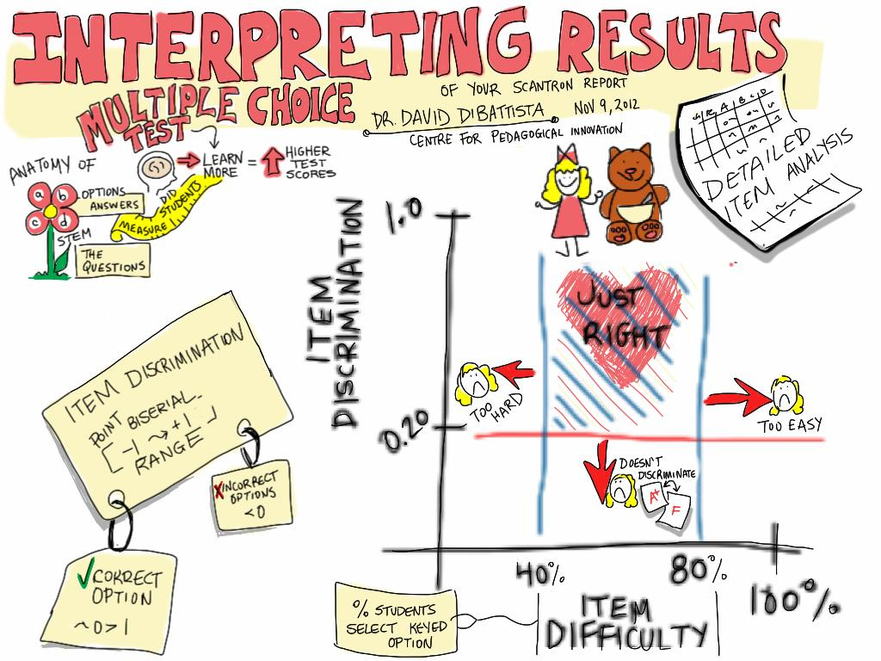
Results
And insights

Slide 20
Interpreting our results
What’s behind a 90% “recall” score:
Out of 100 people, our model would produce 10 false negative, meaning 10 customers who would actually churn would be wrongly predicted as not churning.

Slide 21
Interpreting our results
Our first model showed that contract type and internet services where the most important features.
Removing this features shows that additional services, payment method and gender are the next most important features.
Careful the model does not tell us the direction of the trend.

Slide 22

Recommendations

Slide 23
Areas to focus on
Convert monthly customers to annual
Investigate the relationship between internet services and churn
Sell additional services
Provide benefits for using payment with automatic renewal
Investigate why women are more likely to churn

Slide 24

Future Scope

Slide 25
How to take this forward
Monthly churn predictions can be sent to sales teams to design promotions for customers who are likely to churn
Data of churn for customers who have left after offers can be collected to identify success of outreach efforts to retain customers
Trend of churn over a period of time can be used to asses model

Slide 26

Thanks!

